Slide 1
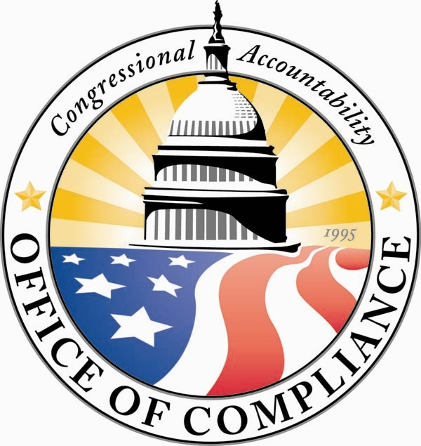
Office of Compliance
advancing safety, health and workplace rights in the United States Congress
www.compliance.gov
Notes:
Good afternoon. Thank you for that introduction. I am pleased to be with you today and honored to appear on this panel of such distinguished presenters. My name is Tamara Chrisler, and I am the Executive Director of the Office of Compliance. Before I speak about the details of the Office of Compliance, I’d like to share a little about the structure of the Federal Government in the United States.

Slide 2
Structure of Federal Government
Legislative
Congress
Makes the Laws
Executive
Office of the President
Applies the Laws
Judicial
Supreme Court
Interprets the Laws
Notes:
The Federal Government is made up of three different branches: the Legislative, the Executive, and the Judicial. The Legislative Branch of our Government is comprised of elected officials who represent residents of communities across our country. They are Senators and Congressmen and women. who write our Federal laws. The second branch is the Executive Branch. This Branch holds the Office of the President of the United States, and this Branch applies the laws as they are written by Congress. The third Branch is our Judicial Branch. It is made up of all of our Federal Courts: District Courts (of first impression), Courts of Appeals (on 1st review), and the Supreme Court (the final judicial review). The Federal Courts interpret the laws written by Congress and enforced by the Executive Branch. Each Branch of Government is separate from another. This “Separation of Powers” is designed to provide a checks and balance among the branches of Government.

Slide 3
Application of Workplace Laws
Congress Makes the Laws
Executive/ Judicial
Private Sector
Legislative Branch
Notes:
As the Branch that creates the law, Congress has historically written workplace rights laws and applied them to the Executive Branch, the Judicial Branch, and the private sector, which includes companies, corporations, small business and the like. At the time of their enactment, these workplace rights laws did not apply to Congress. Certain employers in the Legislative Branch had policies in place that prohibited discrimination, and they had procedures by which employees could pursue claims, but the claims were not considered a violation of the law, because the law did not apply to Congress.

Slide 4
1995 Congressional Accountability Act
Workplace Laws
Remedies for Violations
Congressional Accountability Act
Notes:
In 1994, there was a growing, collective voice of Congressional Members who expressed their dissatisfaction with exempting Congress from these workplace laws. They wanted Congress to be held accountable for the same employment and safety laws that applied to other employers. The Congressional Accountability Act of 1995 was passed to make that happen. Ensuring that employees had a formal avenue for presenting their claims and receiving remedies was also a component of the Congressional Accountability Act.

Slide 5
Categories of Workplace Laws
Civil rights
Gender, race, religion, national origin, color
Age
OSHA and Public Access
Safety
ADA Public Access
Other
Veterans’ rights
Polygraph
Physical/Mental Disability
Retaliation
Health
Layoffs
Pay standards
Family and medical leave
Genetic Information
Notes:
The Congressional Accountability Act, or the CAA, applies thirteen existing workplace rights laws to the Legislative Branch. Those laws include protecting employees from discrimination in the performance of their job duties based on gender, race, religion, national origin, color, age, physical or mental disability, and genetic information. Employees are also protected from retaliation by employers for exercising their rights under the CAA. Safety and health protections are included to ensure that employees work in environments free from hazardous conditions. In addition, there are provisions that speak to disability access for visitors, restrictions on polygraph testing for employees, and re-employment rights for certain eligible veterans.

Slide 6
Equivalent Executive Branch Agencies
EEOC – Civil Rights
OSHA – Safety and Health
FLRA – Labor/Management
Notes:
In the Executive Branch of Government, these workplace rights laws are enforced by several different Executive Branch agencies: the Equal Employment Opportunity Commission, or EEOC, enforces anti-discrimination laws; the Occupational Safety and Health Administration, or OSHA, enforces safety standards to ensure hazard-free workplaces; and the Federal Labor Relations Authority, or the FLRA, ensures fair negotiations between labor unions, its employees, and management. Because of the “Separation of Powers” doctrine, Congress did not use these Executive Branch agencies to enforce the laws under the CAA. Instead, it created an independent, non-partisan agency within the Legislative Branch to enforce the rights and protections of the CAA. That agency is the Office of Compliance.

Slide 7
Establishment
Congress
Board of
Directors
Officers
Notes:
The Office of Compliance is comprised of a five-member Board of Directors who are experts in the laws covered by the CAA, and who are appointed by the Leadership of Congress. The Board of Directors appoints four Officers within the agency: an Executive Director, two Deputy Executive Directors, and a General Counsel. Though Congress provides certain oversight of the agency, the Office of Compliance remains independent with respect to its enforcement of the provisions of the CAA.

Slide 8
Areas of Jurisdiction
OOC
Agencies
House
Offices
Senate
Notes:
The CAA gives the Office of Compliance jurisdiction to provide services to these employing offices and their employees: Members of the Senate, Members of the House of Representatives, and agencies and offices, such as the Office of the Architect of the Capitol, the United States Capitol Police, and the Office of the Attending Physician, just to name a few. Because Members of Congress have offices throughout the United States, our jurisdiction spans the entire nation, not just Capitol Hill. We provide services for approximately 35,000 employees.

Slide 9
What We Do – Statutory Mandates
Employees & Employers
Dispute Resolution
Inspections
Safety & Health
Drafted by OOC for Congressional approval
Regulations
Publications & Training
Education & Outreach
Notes:
With a small staff of about 28 employees and contractors, the Officers of the agency oversee the implementation of a dispute resolution program, enforce safety and health provisions of the CAA, and educate Congressional offices and employees of their rights and obligations under the statute. The Board of Directors oversees the work of the Officers and is specifically responsible for drafting regulations to implement the laws of the CAA, serving as an appellate tribunal, and reporting on the applicability of labor and employment laws to the Legislative Branch.

Slide 10
Services Provided
Information and Advice
Informal Inquiries
Safety and Health Inspections
Training and Education
Briefings, Seminars
Publications
Dispute Resolution
Counseling, Mediation
Hearing, Appeal
Notes:
As much as we have an enforcement component to our mission, we are also a resource to Congressional employees and employers, and we provide services to assist in the advancement of workplace rights. We provide information to employees and employers about their rights and responsibilities under the CAA. We provide written publications, training, seminars, workshops, and briefings. And of course, our alternative dispute resolution program allows an employee and employing office to resolve their disputes confidentially and at the lowest level prior to bringing a formal complaint before a judge.

Slide 11
Laws vs. Policies
Laws
Practice
Policies
Notes:
The laws covered by the CAA apply to every employing office in the Legislative Branch, including Senators and Congressmen and women. Because each Member’s office is its own employing office, there may be a policy that a Congressman has established in his office that differs from a policy that a Senator has established in her office. And that’s okay. Each Member has the right to set his or her own policies and practices within his or her own office, as long as those policies and practices do not violate the laws covered in the CAA.

Slide 12
Laws vs. Policies
More benefits: Allowed
Less benefits: Prohibited
Notes:
As such, a Member may give an employee MORE benefits than the CAA provides, but a Member may not give an employee LESS benefits than the CAA provides. For example, the CAA allows eligible employees up to 12 weeks of unpaid leave for certain family and medical reasons. A Member’s office may decide to give the employee 12 weeks of paid leave or 18 weeks of unpaid leave . . . More than the CAA provides. On the other hand, if the employee meets the eligibility criteria under the CAA, the Member may not allow the employee only 4 weeks of unpaid leave, which is less than the 12 weeks that the CAA provides.

Slide 13
Maintaining a Balance
Discrimination
Diversity
Notes:
Maintaining a balance between laws and policies is also tested when employers follow anti-discrimination laws and develop policies to promote diversity. Making hiring decisions based on race or gender, for instance, may violate anti-discrimination laws. These personnel decisions are to be made free of consideration of an applicant’s race, gender, age, national origin, etc. However, maintaining a level of diversity among staff is equally important as following the law. Employers often have found that diversifying the applicant pool and focusing recruitment efforts on under-represented groups will allow them to increase the diversity among their staff without running afoul of the law.

Slide 14
Education is Key
Website
Workshops
Training
Publications
Notes:
In order to address all of these issues, we have found that educating employees about their rights and informing employing offices about their responsibilities is key to ensuring the advancement of workplace rights. The Office of Compliance prepares and distributes numerous publications about the laws under the CAA and our services, some of which I have shared with you today. As I have mentioned, we provide training to employing offices, interactive workshops on alternative dispute resolution methods, and workshops on advancements in the area of safety and health. We find that our most effective educational tool, however, is our website: www.compliance.gov. It is comprehensive and easily accessible. All of our publications can be downloaded from the site, and it is currently being upgraded to allow for web training.

Slide 15
Office of Compliance
advancing safety, health and workplace rights in the United States Congress
www.compliance.gov
Notes:
I would like to thank you for your attention while I shared with you information about the Office of Compliance of the United States Congress. I look forward to discussing your issues at length with the other panel members.

